Slide 1

Microsoft Azure Well-Architected Build and manage high-performing workloads

Slide 2
Agenda
● Why is being Well-Architected important?
● Overview: Microsoft Azure Well-Architected
● Overcoming workload quality inhibitors
● How to get started with the Well-Architecture Framework
● Resources

Slide 3


Data breaches cost you —and your customers
Customers’ PII was the most frequently, and costliest compromised type of record per latest data breach study*
$3.86M
Average total cost of a data breach
80%
Number of breaches carried out with customer PII
$150
Customer PII average cost per record
$175
Increased cost per record of customer PII in breaches caused by a malicious attack
$137,000+
Remote workforce impact on average total cost of data breaches
*Cost of a Data Breach Report 2020, IBM Security, Ponemon Institute.
Notes:
Data breaches have a negative and real dollar impact for your organization and affect your customers as well.
Review the numbers on data points—what is the impact to organizations and their customers?
What can organizations proactively do to help avoid costly pitfalls like increased spend, loss of trust, and costly aftermath of breaches?

Slide 4





Run Well-Architected cloud workloads— to create business value
Invest in these actions:
To avoid these consequences:
Manage budget
Improve workloads security
Increase incident response
Streamline internal processes
Find costly mistakes
Enhance workload performance
Expenses, losses
Trust
Damages
Notes:
It’s critical for an organization to avoid or minimize impact of not running well-architected workloads, because the impact is clear and tangible.
By managing and understanding your budget to avoid ‘surprises’ in the invoice, establishing processed that drive efficiencies, designing workload architectures to avoid costly mistakes down the road, making sure these are secured and the data is protected, and having proper incident response plans that allow faster, more efficient reaction to failure –which is gong to happen, inevitably- the organization will minimize or avoid incurring in expenses and revenue loses, negatively impacting their customer’s trust and their reputation, and having to invest time and money in doing incident forensics and damage control –from PR, reimbursements and fees-, after the incident.
For this, we created the Microsoft Azure Well-Architected Framework for you—helping you with guidance from proper design and technical considerations, to operations efficiency and security.

Slide 5




Azure Well-Architected Build and manage high-performing workloads
Build workloads with confidence with proven best practices
Design high-performing workloads using deep technical guidance
Optimize workloads with actionable focus areas
Azure
Well-Architected
Review
Well-Architected
Recommendation
Process
Azure
Advisor
Reliability
Cost Optimization
Azure
Well-Architected
Framework
Operational Excellence
Performance Efficiency
Architecture
Center
Documentation
Security
Partners, Support &
Services Offers
Notes:
With the Microsoft Azure Well-Architected Framework you can BUILD workloads with confidence based on proven deep technical guidance, that is actionable and simple-to-use, and helps you identify areas of improvement, and where to focus your workloads optimization efforts.​
​
Well-Architected enables you to achieve three things…..
BUILD with confidence across all workload deployments and operations against.
DESIGN workloads using actionable and simple-to-use deep technical guidance.
PERFORM gap analysis to identify areas of improvement, and where to focus optimization efforts.
The framework is at the center of an ecosystem of best practices, documentation, assessments, reference architecture, and design principles. All this supported and amplified by Partners and Services offers to guide and assist you in improving your workloads’ quality.​
​
Azure Well-Architected Framework enables you to achieving your business objectives, operationalizing how to design, build, and optimize cloud solutions.​
Microsoft Azure Well-Architected Review provides evaluates workloads with gap analysis and identifies areas of where to focus your optimization efforts.​
Reference Architectures help you to build and deploy any workload to scale and meet your business needs.​
Design principles based on proven practices and design patterns from successful customer and partner deployments.​
Microsoft Partner & Service Offers support you—and help you build effective cloud solutions.​
But, building optimized workloads is a shared responsibility.

Slide 6
Building well-architected workloads is a shared responsibility
Scope of
Well-Architected Assessments
Customer application
Customer app or workload, built on the Azure platform
Platform features
Optional Azure capabilities a customer enables – to ensure security, reliability, operability, performance
Platform foundation
Core capabilities built into the Azure platform – how the foundation is designed, operated, and monitored
Notes:
This is a shared responsibility. Microsoft enables it with the proper capabilities and features in its platform, but the customer has to build it leveraging those capabilities correctly.
Azure's hybrid model—with unified operational management control processes and governance management—offers multiple solutions, enabling customers to confidently deliver hybrid workloads.
Azure provides customers with the controls, methods, tools, and support
The customer brings a deep understanding of their goals, constraints, and requirements, along with knowledge specific to their industry.

Slide 7

Microsoft Azure Well-Architected Framework
Architecture guidance and best practices, created for architects, developers and solution owners, to improve the quality of their workloads, based on 5 aligned and connected pillars
Cost Optimization
Operational Excellence
Performance Efficiency
Reliability
Security
https://aka.ms/wellarchitected/framework
Notes:
Microsoft Azure Well-Architected Framework enables cloud solution success.
Well-architected
Operationalizes Microsoft Azure Well-Architected Framework’s 5 principles : cost optimization, operational excellence, performance efficiency, and reliability.
Design, build, and optimize cloud solutions, using architectural guidance, assessments, and industry best practices.
Cost-Optimization: Design "pay-as-you-go" cost-effective workloads, aligned with business objectives/ROI, while maintaining a budget.
Operational Excellence: Design reliable, predictable, automated deployments, with monitoring, performance management, and extensive automated and manual testing from an infrastructure and application perspective.
Performance Efficiency: Lower maintenance costs, improve user experience, and increase agility by architecting solutions with scalability baked-in. Move to PaaS by default, to use built-in scaling functionality.
Reliability: Scale out instead of scaling up with expensive hardware, and build reliability across deployments with resilient, HA applications, and failure mode analysis.
Security: Build with security by design--to provide confidentiality, integrity, and availability assurances against deliberate attacks and abuse of your valuable data and systems.

Slide 8



It’s all about the trade-offs Business requirements influence workload architecture decisions
Dev/Test Workloads
Mission-Critical Workloads
Securing all Workloads
https://aka.ms/wellarchitected/framework
Notes:
Do you have to make trade-offs in an enterprise context? Most often, yes!
Development workloads: Optimizing costs in dev workloads may be the right approach, even when it may impact reliability, if it is in line with business expectations
Mission-critical workloads: Improving performance for a mission-critical workload may be the right business decision, even at the expense of increased costs.
Securing all workloads: Surge in cyber attacks drive workload security investments, as organizations attempt to protect their most valuable asset: data

Slide 9
Overcoming workload quality inhibitors
Cost Optimization
Operational Excellence
Performance Efficiency
Reliability
Security
No cost and usage monitoring
Unclear on underused or orphaned resources
Lack of structure billing management
Budget reductions due to lack of support for cloud adoption by LT/board
Lack of rapid issue identification
No deployment automation
Absence of communication mechanisms and dashboards
Unclear expectations and business outcomes
No visibility on root cause for events
No monitoring new services
No monitoring current workloads health
No design for scaling
Lack of rigor and guidance for technology and architecture selection
Unclear on resiliency features/capabilities for better architecture design
Lack of data back up practices
No monitoring current workloads health
No resiliency testing
No support for disaster recovery
No access control mechanism (authentication)
No security threat detection mechanism
Lack of security thread response plan
No encryption process
https://aka.ms/wellarchitected/framework
Notes:
These are a sample of the quality inhibitors to look out and that could be addressed by the guidance included in Microsoft WAF, representing both the breadth and depth of guidance provided by Microsoft.

Slide 10
Best practices to drive workload quality
Cost Optimization
Operational Excellence
Performance Efficiency
Reliability
Security
Azure Hybrid Benefit
Reserve Instances
Shutdown
Resize
Move to PAAS
DevOps
Deployment
Monitor
Processes and cadence
Design for scaling
Monitor performance
Define requirements
Test with simulations and forced failovers
Deploy consistently
Monitor health
Respond to failure and disaster
Identity and access management
Infra protection
App security
Data encryption and sovereignty
Security operations
https://aka.ms/wellarchitected/framework

Slide 11
Cost Optimization

Slide 12
Cost optimization = top cloud initiative for the fifth year running
Notes:
Research underscores that cost optimization is a key point of focus for customers.
We’ve heard from many of our customers that cost optimization is one of the top IT priorities at their organizations once again. The global health pandemic has put a new focus on financial rigor and ensuring dollars are well-spent. Flexera’s 2021 State of the Cloud Report shows that this is true across the industry and optimizing spend has been the top cloud initiative for five years running.

Slide 13
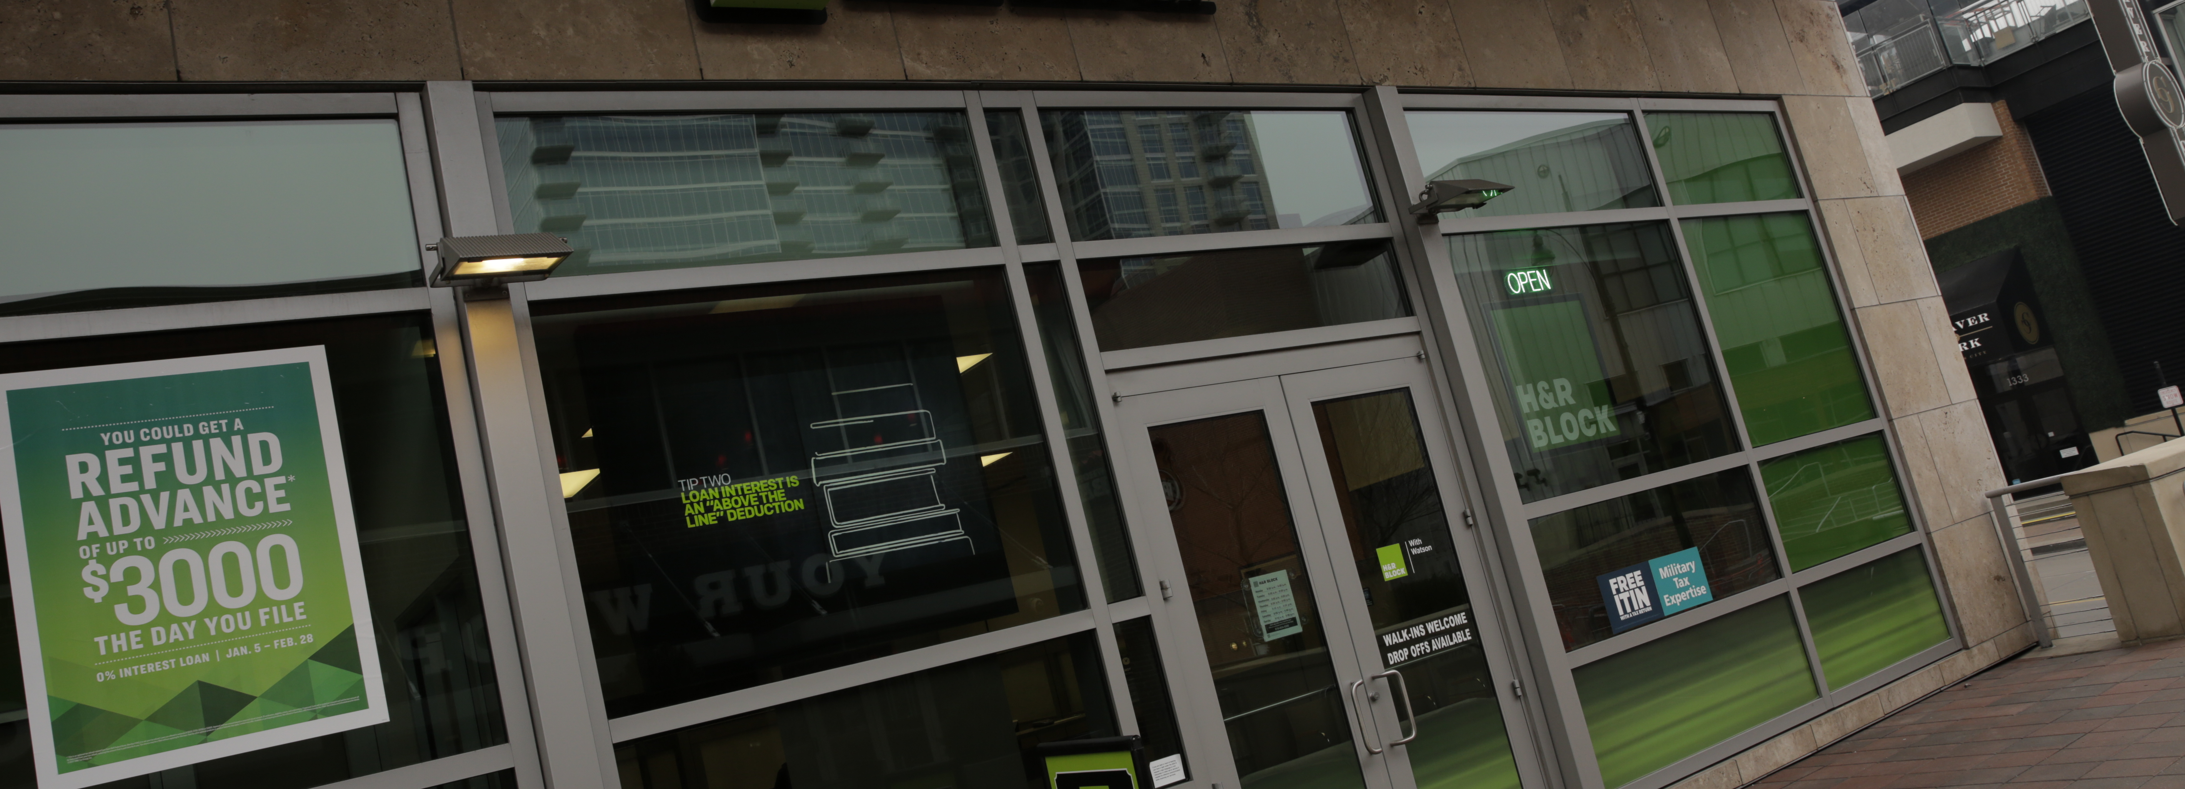
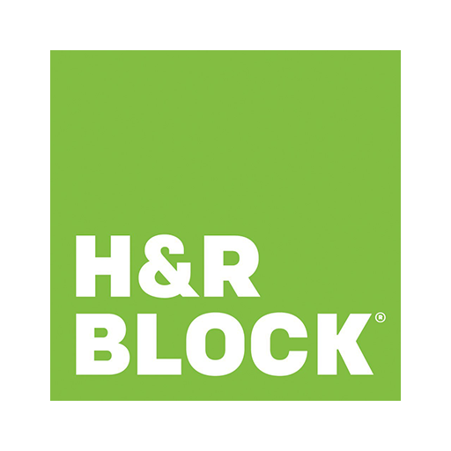
Customer Story – H&R Block
Customer: H&R Block
Industry: Professional Services
Size: 10,000+ employees
Country: United States
Products and services: Microsoft Azure
Microsoft Azure Advisor
Microsoft Azure Cost Management and Billing
Microsoft Azure Well-Architected Framework
Read full story here
“Our monthly spend year-over-year is nearly flat, while we now have approximately 30 percent more of our total compute in the cloud. Thanks to our partnership with Microsoft, our team has learned valuable techniques and strategies to continue optimizing our spend.”
—Paul Clark, Director of Cloud, H&R Block
As a leader in the modernization of the tax industry, H&R Block wanted to optimize its cloud infrastructure and provide better service for its customers.
By engaging with its Microsoft account team and taking advantage of Azure Well-Architected Framework concepts, the company was able to optimize by replatforming to cloud-native services and modernizing its operating models.
H&R Block is now equipped to take control of its monthly spend while also being able to move its total compute to the cloud and use its capabilities to benefit its business and customers.

Slide 14

Cost optimization categories
Organizational
Architectural
Tactical
Notes:
You can think of cost optimization in three main categories: organizational, architectural, and tactical.
Organizational: This is where we review your processes and related actions (anything from cultural aspects and beyond) to get good insights into how to improve your current footprint. Examples include:
Tagging
Charge/Show back models (Transparency of the data)
ACM Budgets and Alerts (Targets and Forecast)
Onboarding process (intake process, request forms, etc.)
Architectural: This is where we look at the current footprint design, why are you in IaaS, can workloads go into PaaS and beyond (serverless). Examples include:
Azure Hybrid Benefit (AHB) for SQL and Windows
PaaS and serverless considerations
Tactical: this is where we look into areas of how your teams are using the day-to-day tools, rhythm of cadence (Azure Advisor) and so forth.
Auto-shutdown
Right Sizing
Reserved Instances

Slide 15
Optimize costs with tools, offers, and guidance
Cost optimization guidelines accelerating time to market, while avoiding capital-intensive solutions
Understand and forecast your costs
Cost optimize your workloads
Control your costs
Monitor your bill, set budgets, and allocate spending to teams and projects with Azure Cost Management + Billing
Forecast costs for future investments with the Azure pricing and TCO calculator
Optimize your resources with Azure Advisor
Follow best practices for workload design with the Azure Well-Architected Framework
Save with Azure offers and licensing terms like the Azure Hybrid Benefit and Reservations
Establish spending objectives and policies using the Microsoft Cloud Adoption Framework for Azure
Implement cost controls in Azure Policy so your teams can go fast while complying with policy
Notes:
We’d like to conduct an engagement with you to help you manage and optimize your Azure costs and become more efficient with your Azure footprint. Cost optimization is always important, but now more than ever.
Purpose of engagement = to answer frequently asked questions:
Why is my bill so high?
Where am I spending the most?
I was told the cloud was going to be cheaper, what happened?
Can I move to PaaS or modernize to reduce costs?
How do I get my organization to think differently, to have “cost awareness” part of their DNA?
How do I provide visibility to my business units on their spending?
The goal is to help you become more efficient so you can be more successful in the cloud and ultimately choose the cloud for more of your workloads. The three buckets of areas on the screen are where we’ll focus. First, understanding your costs. Then cost optimizing your workloads. And finally helping you put in place practices to control your costs going forward. Here are some of the tactical things we’ll end up doing together, if you agree to proceed with us:
Right sizing your environment
Identifying unused/”orphaned” resources
Getting more density with your compute
Identifying Reservation, Hybrid Benefit, and Spot VM opportunities
Identifying workloads that can move up the Azure stack (PaaS and SaaS)
Let’s review this pillar’s guiding principles:
Keep within the cost constraints
Aim for scalable costs
Pay for consumption
Right resources, right size
Monitor and optimize

Slide 16
Understand & forecast your cost Principle: Monitor & optimize
Use alerts to monitor usage and spending
Auto-scaling policies provide cost savings
Reserved instances can reduce costs
Budget alerts notify you when spending reaches predetermined thresholds.
Credit alerts notify you when your Azure Prepayment is consumed.
Department spending quota alerts notify you when quotas are reached.
When workloads are highly variable, choose smaller VM instances, then scale out, rather than up, to get the needed performance.
Many applications can be made stateless, then auto-scaled for cost benefits.
Use Azure Reservations to lower costs by pre-paying for capacity.
Analyze existing pay-as-you-go usage data in Azure Portal before opting into reserved instances.
Notes:
The Monitor and Optimize principle states that you should treat cost monitoring and optimization as a process, rather than a point-in-time activity. What does that mean? Let’s discuss some specifics:
Conduct regular cost reviews and measure and forecast the capacity needs so that you can provision resources dynamically and scale with demand. Review the cost management recommendations and take action to optimize workload costs. Use Advisor Score to identify the greatest opportunities for cost optimization for your workload.
Set budgets and alerts: A cost-effective workload is driven by business goals and the return on investment (ROI) while staying within a given budget. The principles of cost optimization are a series of important considerations that can help achieve both business objectives and cost justification.
Respond to Alerts: When you receive an alert, check the current consumption data. Budget alerts aren't triggered in real time. There may be a delay between the alert and the current actual cost. Look for significant difference between cost values when the alert happened and the current cost. Next, conduct a cost review to discuss the cost trend, possible causes, and any required action. For information about stakeholders in a cost review, see Cost reviews.
Revise your budgets based on analysis of spending data: After you identify and analyze your spending patterns, you can set budget limits for applications or business units. You'll want to assign access to view or manage each budget to the appropriate groups. Setting several alert thresholds for each budget can help track your burn down rate.
Autoscaling: In Azure, it’s easier to grow a service with little to no downtime against downscaling a service, which usually requires deprovisioning or downtime. In general, opt for scale-out instead of scale up. For certain application, capacity requirements may swing over time. Autoscaling policies allow for less error-prone operations and cost savings through robust automation. For auto scaling, consider the choice of instance size. The size can significantly change the cost of your workload.
Stateless Applications: Many Azure services can be used to improve the application's ability to scale dynamically. Even where they may not have been originally designed to do so. For example, many ASP.NET stateful web applications can be made stateless. Then they can be auto scaled, which results in cost benefit. You store state using Azure Redis Cache, or Cosmos DB as a back-end session state store through a Session State Provider.
Reservations: Azure Reservations are offered on many services as a way to lower cost. You reserve a prepaid capacity for a period, generally one or three years. With reserved instances, there’s a significant discount when compared with pay-as-you-go pricing. You can pay up front or monthly, price wise both are same.

Slide 17
Control your cost Principle: Keep within cost constraints
Develop a cost model
Capture requirements
Cost tradeoffs
Map your organization's needs to specific offerings.
Start with high-level requirements before considering design.
Geographic and security decisions can have a huge impact on your costs.
Break down high-level goals into functional requirements.
For each functional requirement, define metrics to estimate costs.
Determine if the cost of high availability exceeds acceptable downtime.
Increasing security of the workload will increase cost.
Systems monitoring and automation might increase the cost initially but will reduce cost over time.
Notes:
Every design choice has cost implications. Before choosing an architectural pattern, Azure service, or a price model for the service, consider the budget constraints set by the company. As part of design, identify acceptable boundaries on scale, redundancy, and performance against cost. After estimating the initial cost, set budgets and alerts at different scopes to measure the cost. One of cost drivers can be unrestricted resources. These resources typically need to scale and consume more cost to meet demand.
Cost modeling is an exercise where you create logical groups of cloud resources that are mapped to the organization's hierarchy and then estimate costs for those groups. The goal of cost modeling is to estimate the overall cost of the organization in the cloud.
An inappropriate or misconfigured service can impact cost. For example, building a multi-region service when the service levels don't require high-availability or geo-redundancy will increase cost without any reasonable business justification. Certain infrastructure resources are delivered as fix-sized building blocks. Ensure that these blocks are adequately sized to meet capacity demand, deliver expected performance without wasting resources.
As requirements are prioritized, cost can be adjusted. Expect a series of tradeoffs in the areas that you want to optimize, such as security, scalability, resilience, and operability. If the cost to address the challenges in those areas is high, stakeholders will look for alternate options to reduce cost. There might be risky choices made in favor or a cheaper solution.
Overall Service Level Agreement (SLA), Recovery Time Objective (RTO), and Recovery Point Objective (RPO) may lead to expensive design choices. If your service SLAs, RTOs, and RPOs times are short, then higher investment is inevitable for high availability and disaster recovery options. For example, to support high availability, you choose to host the application across regions. This choice is costlier than single region because of the replication costs or the need provisioning extra nodes. Data transfer between regions will also add cost. If the cost of high availability exceeds the cost of downtime, you can save by using Azure platform-managed replication and recover data from the backup storage.
Locating resources in a cheaper region should not negate the cost of network ingress and egress or by degraded application performance because of increased latency.
An application hosted in a single region may cost less than an application hosted across regions because of replication costs or the need for extra nodes.

Slide 18

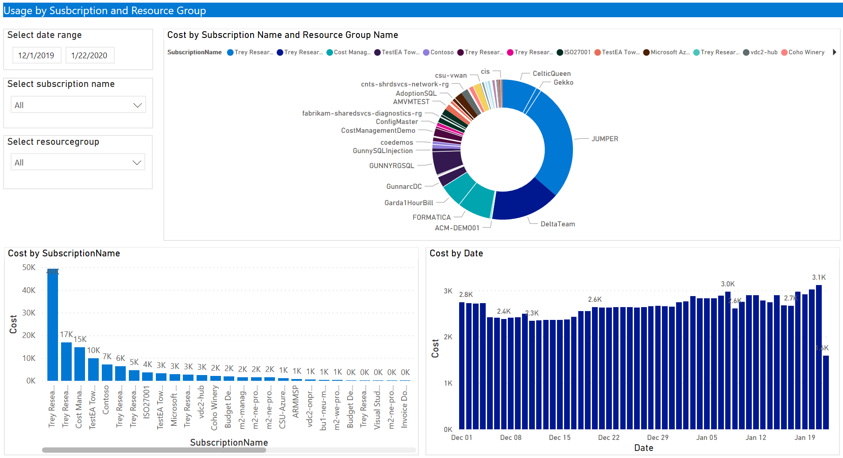
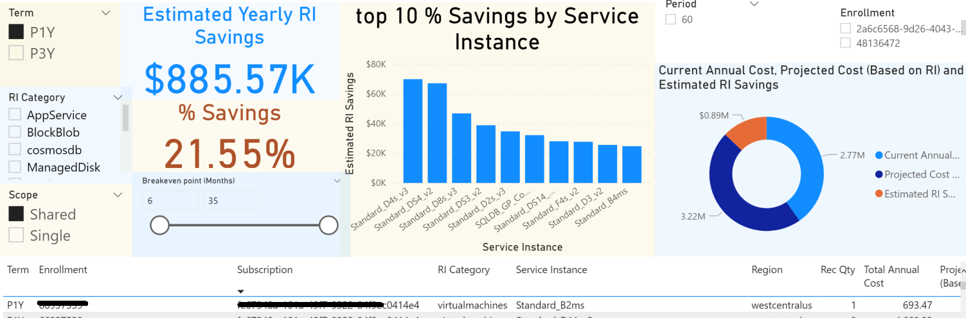
* Azure Cost Management + Billing Power BI App + RI Recommendations Dashboard​
Reports included:
Account overview
Usage by Subscriptions and Resource Groups
Top 5 Usage drivers
Usage by Services
Windows Server AHB Usage
VM RI Coverage (shared recommendation)
VM RI Coverage (single recommendation)
RI Recommendations for all eligible services (Single/shared scope and 1Yr/3Yr terms)
RI Savings
RI Chargeback
RI purchases
Pricesheet
EA admin: run the ACM Power BI Template App and share the results with the Microsoft team
Notes:
Available from AppSource
Built from the ACM Power BI desktop connector

Slide 19
Operational Excellence

Slide 20


Build, deploy, and manage workloads with trustworthy processes
Operational Excellence offers you the guidelines to create a sustainable application environment within building, deploying and maintaining workloads, while relying on automation, monitoring and testing.
Agile and Accurate Processes
Focused and assertive application monitoring
Continuous
Improvement
Apply DevOps to break down barriers between development and operations within the cloud journey.
Reduce process risks by automating workloads with Azure Automation, Azure CLI and Azure PowerShell.
Enjoy the flexibility of creating agile and independent workloads with Microservices.
Dive deep into your workloads' information with Log Analytics for infrastructure and with Azure Application Insights for application trends.
Manage the health of your system and activity logging by consuming core monitoring insights provided by Azure Monitor.
Build and test workloads with Continuous Integration and Continuous Delivery (CI/CD) both in development and production stages.
Perform extensive automated testing with Azure Pipelines or manual testing with Azure Testing Plans.
Notes:
The Operational Excellence pillar focuses on the use of built-in tools in Azure to help you to improve your workload performance. We also separate the Performance Efficiency guidance in 3 key benefits that will make a different in the management of your applications.
• Agile and Accurate Processes: Build, deploy and maintain workloads with DevOps mindset and procedures, to integrate all parts of the development process and reduce dependency from manual workloads.
• Focused and assertive application monitoring: Have visibility of fundamental infrastructure and deep application data to ensure appropriate management of the workload environment.
• Continuous Improvement: Create and improve workloads with structured testing to mitigate risks and improve environment consistency between development and production stages.

Slide 21
Agile and accurate processes Principle: optimize build and release processes
From provisioning with Infrastructure as Code, to build and releases with CI/CD pipelines, to automated testing, embrace software engineering disciplines across your entire environment.
Infrastructure as Code
Continuous Integration & Continuous Delivery
Automated testing
Define the entire Infrastructure as Code just as you define your application
Increase accuracy and reduce process risks preventing configuration drift
Enable easy recreation of new environments, e.g., for developing new features
Build and test workloads with Continuous Integration and Continuous Delivery (CI/CD) both in development and production stages, to achieve a single and consistent way of building and deploying.
Eliminate error-prone manual interventions
Versioning of CI/CD pipelines for traceability of changes
Perform extensive automated testing to ensure a stable code base and resource composition before deploying to critical systems
Achieve a faster time-to-ship with fewer errors
Notes:
It is also helpful, for context, to understand the main topics/processes of Operational Excellence. The next one is the agile build and release processes.
From provisioning with Infrastructure as Code, building and releasing with CI/CD pipelines, automated testing, and embracing software engineering disciplines across your entire environment.
This approach ensures the creation and management of environments throughout the software development lifecycle is consistent, repeatable, and enables early detection of issues.

Slide 22
Focused and assertive application monitoring Principle: Monitor system and understand operational health
Implement systems and processes to monitor build and release processes, infrastructure health, and application health. Telemetry is critical to understanding the health of a workload and whether the service is meeting the business goals.
Monitor build and release processes
Understand workload health to meet business goals
Monitor infrastructure and application health
Give developers early feedback on pushed code changes
Avoid outages caused by the rollout of new features
Understand the business impact of reduced workload health
Correlate events and metrics across different parts of your solution
Respond to issues with self-healing capabilities
Build confidence in the overall health of your workload
Dive deep into instrumentation with Log Analytics for infrastructure monitoring
Instrument your code to collect all relevant events and metrics
Use comprehensive dashboards that are tailored to your audiences
Leverage Azure Application Insights for observing application trends
Notes:
It is also helpful, for context, to understand the main topics/processes of Operational Excellence. The focused and assertive monitoring.
Implement systems and processes to monitor build and release processes, infrastructure health, and application health.
Telemetry is critical to understanding the health of a workload and whether the service is meeting the business goals.

Slide 23
Enable teams to independently test, deploy, and update their systems on demand without depending on other teams for support, services, resources, or approvals.
Continuous Improvement Principle: Use loosely coupled architecture
Strive for a true DevOps model
Microservices design
Apply DevOps to break down barriers between development and operations within the cloud journey.
Run agile and independent teams that are in charge of developing and running their parts of the workload
Limit impact of issues by having clear boundaries between services
Enjoy the flexibility of creating agile and independent workloads with microservices.
Notes:
This modular approach allows for more autonomy and flexibility
Continuously evaluate and refine operational procedures and tasks while striving to reduce complexity and ambiguity.
This approach enables an organization to evolve processes over time, optimizing inefficiencies, and learning from failures.
The goal of workload isolation is to associate an application's specific resources to a team to independently manage all aspects of those resources.

Slide 24
Continuous Improvement Principle: rehearse recovery and practice failure
Run DR drills on a regular cadence and use chaos engineering practices to identify and remediate weak points in application reliability. Regular rehearsal of failure will validate the effectiveness of recovery processes and ensure teams are familiar with their responsibilities.
Rehearse recovery
Practice failure
Only tested recovery procedures will work in times of emergency
Validate operation runbooks
Run regular tests and conduct dry runs of failover scenarios
Test your workload with injected faults in a safe environment
Use Chaos Engineering practices to reach higher levels of maturity
Employ a “Red Team” to find issues and weak points
Notes:
Planning for failure is important, so that if and when it does happen, you know what steps to take in each scenario.
When incidents occur, have well thought-out plans and solutions for incident management, incident communication, and feedback loops.
Take the lessons learned from each incident and build telemetry and monitoring elements to prevent future occurrences.
Planning isn’t a “one-and-done” exercise. Let’s talk next about the process of review and refinement.

Slide 25
Continuous Improvement Principle: embrace operational improvements
Continuously evaluate and refine operational procedures and tasks, while striving to reduce complexity and ambiguity. This approach enables an organization to evolve processes over time, optimizing inefficiencies and learning from failures.
Optimizing inefficiencies through automation
Evolve processes
Having well-defined owners and playbooks for procedures and tasks is vital to optimizing operational effectiveness.
Testing operational procedures and tasks should occur according to a reasonably regular cadence.
Review operational incidents to improve operational effectiveness.
Establish a Root Cause Analysis processes.
Save time, reduce risks and avoid errors by automating operational tasks or any deployments that may occur on a schedule, as a response to an event or monitoring alert, or ad-hock based on external factors.
Automate deployments Infrastructure as Code to define the infrastructure that needs to be deployed.
Optimize your workload configuration by automating software installs, adding data to a database, updating networking and other actions.
Notes:
Operational Excellence is an ongoing concern. As your business evolves, you should circle back and review the procedures that you have in place to ensure that they are fully optimized.
Continuously evaluate and refine operational procedures and tasks while striving to reduce complexity and ambiguity.
This approach enables an organization to evolve processes over time, optimizing inefficiencies, and learning from failures.

Slide 26
Performance Efficiency

Slide 27
Build and manage scalable and efficient workloads
Performance Efficiency offers you the guidelines to design and manage workloads that scale according to load changes, and to design efficient systems, monitor processes, and optimize resources
Optimal service execution
Efficient architecture trade-offs
Active response to performance issues
Manage resource scaling with Azure SQL Database and Azure App Services, or automatically with Azure Autoscale
Optimize your network and storage with Azure Cosmos DB, Azure Traffic Manager and Azure Cache for Redis
Design parts of the process to be discrete and decomposable, to maximize compute resources and consider microservices architecture
Evaluate workload health levels with Azure Monitor and Log Analytics, to provision resources dynamically and scale based on demand
Assess and remediate deep application performance issues and trends with Azure Application Insights
Embrace a data-driven culture to deliver timely insights to everyone in your organization across all your data
Client
Microservices
DevOps
Service
Service
API Gateway
Service
Service
Management/Orchestration
Notes:
Performance Efficiency focuses on built-in tools in Azure to improve your workload performance and improve your application management.
• Active response to performance issues: Identify and remediate potential risks and bottlenecks within your applications with analytical tools that provide data from different layers of your system.
• Optimal service execution : Review availability and operation of resources to facilitate network and storage optimization and ensure high quality service to the end users.
• Efficient trade-offs within applications: Build and develop your applications with tools that facilitate efficient trade-off choices between performance and the other well-architected framework pillars.

Slide 28
Optimal service execution Principle: Performance Testing and Capacity Planning
Load testing in pre-production provides insights and evidence on how your workload would perform at various scales, predicting when and how it could fail, so you can identify and fix errors
Test continuously
Anticipate load fluctuations
Carefully evaluate services and costs
Establish baselines for your application and its supporting infrastructure.
Whenever code or infrastructure changes are made, always test the effect on performance.
Knowing typical and peak system loads help you understand when it is operating outside of designed limits.
Test for expected loads due to planned events like sales promotions or holidays.
Plan for unexpected political, economic, and weather events.
Choose paired regions and ensure that all regions can adequately scale to maximize uptime.
Review the Service Level Agreements (SLAs) of similar services to determine which is the best fit for your application.
Consider business requirements impact when making trade-offs between cost and performance.
Use cost calculators to estimate the initial and operational costs.
Notes:
Load Testing helps ensure that your applications can scale and do not go down during peak traffic. Load test each application to understand how it performs at various scales.
Baselines help to establish the current efficiency of your application and its supporting infrastructure. Baselines can provide a good bearing for improvements in your application's performance and helps you determine if the application is meeting the business's KPIs. Baselines can be created for any application regardless of its maturity—a new project or an application that has been running in production for years. No matter when you establish the baseline, performance during continued development can be continuously measured against it. When code and/or infrastructure changes, the effect on performance can be actively measured.
Besides standard performance testing and the constant measurements against your baselines, there are two additional flavors of testing—load and stress testing. Load testing measures your application's performance under predetermined amounts of load. Stress testing measures the maximum load your application and its infrastructure can support before it buckles. Load testing takes places in stages of load. These stages are usually measured by virtual users (VUs) or simulated requests, and the stages happen over given intervals. Load testing provides insights into how and when your application needs to scale in order to continue to meet your SLA to your customers (whether internal or external). Load testing can also be useful for determining latency across distributed applications and microservices.
Bottlenecks are areas within your application that can hinder performance, and the bottleneck typically worsens as load increases. Bottlenecks can be the result of deficiencies in code or misconfiguration of a service.
The first step for determining options for improvement is to ensure that you are capturing telemetry throughout your application. Application Insights provides some great telemetry out of the box, and you can customize what is captured for even greater visibility. Next, you may want to compare your code to proven architectures in the Cloud Design Patterns. By referencing the design patterns, you can avoid common mistakes by developers who are deploying applications into the cloud. Finally, you may consider other Azure services that may be more appropriate for your objectives. While Azure has many services that seem to overlap in capabilities, often there are specific use-cases for which the services are designed.
Loads can be impacted by world events, such as political, economic, or weather changes; by marketing initiatives, such as sales or promotions; or, by seasonal events, such as holidays. You should test variations of load prior to events, including unexpected ones, to ensure that your application can scale. Additionally, you should ensure that all regions can adequately scale to support total load, should one region fail.
Costs can be an additional factor in performance efficiency. But greater costs don't necessarily always mean increased performance. When observing how closely your application comes to meeting business KPIs, you must consider how much improvement will be realized in the application if costs are increased. Then, you must evaluate if the cost-benefit is worth the investment. Sometimes small changes in the application logic, caching, or adding an index to a database can dramatically improve performance while not affecting costs whatsoever (certain improvements can even help reduce costs).

Slide 29
Efficient architecture tradeoffs Principle: Distributed Architecture
Distributed architectures are complex and can require many areas of expertise and as much telemetry captured throughout the application and across all services as possible.
Distributed systems require more effort
Test and tune Performance
Avoid performance anti-patterns
You must consider each application, its supporting services, and the latency between application layers.
Ensure that all services can scale to support loads and that one service will not be a bottleneck.
Services may need to scale differently under loads.
Define a service level objective (SLO) that defines performance targets for latency, number of requests, and exception rate for each workload.
Use proven practices such as properly-instrumenting code, monitoring multiple load percentages, and systemic troubleshooting.
Performance antipatterns are common defective processes and implementations within organizations that are likely to cause scalability problems when an application is under pressure.
Antipatterns may be obvious, such as an inability to scale from on-premises to the cloud.
Notes:
Distributed architectures complex and can require many areas of expertise. To adequately monitor performance, it is critical that as much telemetry as possible is captured throughout the application and across all services. Your team should be equipped with the necessary expertise to troubleshoot all services in your architecture. On occasion, it may be advantageous to use one service over another simply because your team is better equipped to support it. Then, as your team's expertise grows, you can incorporate other technologies.
Scale: For distributed applications, required effort for ensuring performance efficiency is increased exponentially. You must consider each application, its supporting service, and the latency between all application layers.
Anti-patterns: A performance antipattern is a common practice that is likely to cause scalability problems when an application is under pressure. For example, you can have an application that behaves as expected during performance testing. However, when it is released to production and starts to handle live workloads, performance decreases. Scalability problems such as rejecting user requests, stalling, or throwing exceptions may arise.
Fault-handling: Resiliency plays a huge role in performance efficiency as the failure of any service may impact your application's ability to meet your business's KPIs or, worse, scale to meet current load. Chaos testing—the introduction of random failures within your infrastructure—against your application can help determine how well your application continues to perform under varying stages of load.

Slide 30
Active response to performance issues Principle: Monitoring
Define a comprehensive monitoring strategy to consider scalability, resiliency and performance. Use application telemetry and profiling to better identify issues, and Azure Data Explorer and Grafana to identify performance trends captured over time. Additional tools to make use of are …
Azure Monitor
Log Analytics
Application Insights
A comprehensive solution for collecting, analyzing, and acting on telemetry from your cloud and on-premises environments.
Helps you maximize the availability and performance of your applications and services.
Edit and run log queries from data collected by Azure Monitor Logs and interactively analyze the results.
Retrieve records matching particular criteria, identify trends, analyze patterns, and provide a variety of insights into your data.
Assists you in understanding how your app is performing and how it's being used.
Monitors a variety of data including request, response and failure rates, exceptions, page views and load performance.
Notes:
Lack of monitoring new services and the health of current workloads are major inhibitors in workload quality. The overall monitoring strategy should take into consideration not only scalability, but resiliency (infrastructure, application, and dependent services) and application performance as well. For purposes of scalability, looking at the metrics would allow you to provision resources dynamically and scale with demand.
<Talking Points>:
Performance testing should always be based on data captured from repeatable processes. In order to understand how an application's performance is affected by code and infrastructure changes, data must be kept and monitored. Additionally, it is important to understand how performance has changed over time, not just compared to the last measurement taken. It is often helpful to store such data in a time-series database (TSDB) and then view the data from an operational dashboard. An Azure Data Explorer cluster is a powerful TSDB that can store any schema of data, including performance test metrics. Grafana, an open-source platform for observability dashboards, can then be leveraged to query your Azure Data Explorer cluster to view performance trends in your application.
Troubleshooting an application's performance requires continuous monitoring and reliable investigation. Issues in performance can arise from database queries, connectivity between services, under-provision resources, or memory leaks in code. Application telemetry and profiling can be useful tools for troubleshooting your application. Additionally, network traffic capturing tools, such as Azure Network Watcher, can be extremely helpful.
Resolving performance issues requires time and patience—not just in discovery and investigation, but also in resolution. Code enhancements may be accomplished by deploying a new build, but enhancements to infrastructure may involve many teams. Some services may require updated configurations while others may need to be deprecated in favor of more-appropriate solutions. Regardless, it is critical that you understand the scope of your planned resolution so that all necessary stakeholders are informed.

Slide 31
Reliability

Slide 32
Building reliable applications in the cloud— Enable systems to recover from failures and continue to function. In the cloud, we acknowledge up front that failures will happen. The goal is to minimize the effects of a single failing component, instead of trying to prevent overall failure.
Design for reliability
Test for availability & resiliency
Monitoring & diagnostics
Use Availability Zones where applicable to improve reliability and optimize costs.
Design applications to operate when impacted by failures.
Use the native resiliency capabilities of PaaS to support overall app reliability.
Validate that required capacity is within Azure service scale limits and quotas.
Test regularly to validate existing thresholds, targets and assumptions.
Verify how the end-to-end workload performs under failure conditions.
Conduct load testing with expected peak volumes to test scalability and performance under load.
Perform chaos testing by injecting faults.
Define alerts that are actionable and effectively prioritized.
Create alerts that poll for services nearing their limits and quotas.
Use application instrumentation to detect and resolve performance anomalies.
Troubleshoot issues to gain an overall view of application health.
Notes:
Building reliable applications in the cloud means that you can't prevent systemic failure, rather minimize single instances.
Review the main points for Design for Reliability, Test for availability & resilience, and Monitoring & diagnostics.

Slide 33


Customer Story – Push Doctor
Customer: Push Doctor
Industry: Professional Services
Size: 50-999 employees
Country: United Kingdom
Products and services: Microsoft Azure Microsoft Azure App Service Microsoft Azure Application Gateway Microsoft Azure Availability Zones Microsoft Azure Monitor Microsoft Azure Service Bus Microsoft Azure SQL Database Microsoft Power BI Read full story here
“We’ve used Azure to build a resilient platform and help countless people get quick and easy healthcare access they can count on.”
— Paul Smith, Enterprise Architect, Push Doctor
Push Doctor, a patient/doctor video consultation platform based in the United Kingdom, needed highly available and scalable infrastructure that would provide the reliability its patients need to access remote healthcare support on their terms.
Using Microsoft Azure platform as a service resources such as Azure App Service, Push Doctor’s platform is now instantly scalable and highly secure, with an impressive 99.99 percent uptime. And thanks to duplicated workloads, it can seamlessly manage failovers.
Push Doctor can now match patients with a general practitioner in a matter of hours, helping to potentially save the lives of people who would have otherwise waited much longer for a consultation—a service that has proved invaluable during the COVID-19 crisis.
Notes:
Full story: https://customers.microsoft.com/en-us/story/818901-push-doctor-professional-services-azure

Slide 34
Design for Reliability Principle: Design applications to be resistant to failures
Use Availability Zones within a region
Respond to failure
Considerations for improving reliability
Resilient application architectures should be designed to recover gracefully from failures in alignment with defined reliability targets.
Define an availability strategy to capture how the application remains available when in a failure state.
Define a Business Continuity Disaster Recovery strategy for the application and/or its key scenarios.
If greater failure isolation than Availability Zones alone can offer, you should consider deploying to multiple regions.
Multiple regions should be used for failover purposes in a disaster state.
Additional costs—data, networking and the Azure Site Recovery service—should be considered.
Use Platform as a Service (PaaS), which offers native resiliency capabilities to support overall application reliability.
Design your application to automatically scale in and out.
Review Azure subscription and service limits to validate that required capacity is within quotas.
Notes:
Building reliable applications requires failure-resistant design—maintaining uptime, and balancing high resiliency, low latency, and cost.
Review the main points for Use Availability Zones within a region, Respond to failure, and Considerations for improving reliability.
Reliable applications should— maintain a pre-defined percentage of uptime (availability), balance between high resiliency, low latency, and cost (High Availability)—and be able to recover from failures (resiliency).

Slide 35
Test for availability and resiliency Principle: Define, automate, and test operational processes
Testing, testing, testing
Respond to failure
Backup & disaster recovery
Simulation Testing involves creating real-life situations and demonstrates the effectiveness of proposed solutions.
Use Fault Injection Testing to check the system resiliency during failures—by triggering failures or by simulating them.
Load Testing is crucial for identifying failures that only happen under load, (e.g., an overwhelmed back-end database, or service throttling).
Resilient application architectures should be designed to recover gracefully from failures in alignment with defined reliability targets.
Define an availability strategy to capture how the application remains available when in a failure state.
Define a Business Continuity Disaster Recovery strategy for the application and/or its key scenarios.
Create and fully test a disaster recovery plan using the actual resources needed to restore functionality.
Perform an operational readiness test for failover to the secondary region and for failback to the primary region.
Codify the steps required to recover or failover to a secondary region to limit the impact of an outage.
Notes:
Operational processes for application deployment (e.g., roll-forward and roll-back), should be defined, sufficiently automated, and tested to help ensure alignment with reliability targets. This is a clear example of how the pillars in WA Framework are connected and commonly impacting each other when decisions are made in one for another.
Review the main points for Testing, testing, testing, Respond to failure, and Backup and disaster recovery.
Operational processes for application deployment (e.g., roll-forward and roll-back), should be defined, sufficiently automated, and tested to help ensure alignment with reliability targets.

Slide 36
Monitoring application health Principle: Define, automate, and test operational processes
Alerts & dashboards
Subscription & service limits
Backup & disaster recovery
Azure Service Health provides a view into the health of Azure services and regions, as well as communications about outages and planned maintenance activities.
Azure Resource Health provides information about the health of individual and is highly useful when diagnosing unavailable resources.
Azure dashboards provides a consolidated view of data from Application Insights, Log Analytics, Azure Monitor metrics, and Service Health.
If your application requires more storage accounts than are currently available in your subscription, create a new subscription with additional storage accounts.
Identify scalability targets for VMs including VM size, number of disks, CPU, and memory.
To avoid data throttling, review your Azure SQL Database requirements to ensure that they are adequate.
Create and fully test a disaster recovery plan using the actual resources needed to restore functionality.
Perform an operational readiness test for failover to the secondary region and for failback to the primary region.
Codify the steps required to recover or failover to a secondary region to limit the impact of an outage.
Notes:
Monitoring and measuring application availability is important—to move overall application health and progress towards defined reliability targets.
Review the main points for Alerts and dashboards, Respond to failure, and Considerations for improving reliability.
Monitoring and measuring application availability is important— to move overall application health and progress towards defined reliability targets.

Slide 37

Security

Slide 38
Build and manage proactively secured workloads
Security offers you the guidelines to protect, detect, and respond to threats across your Azure environment.
Built on a secure foundation
Proactively stay secure with native controls
Detect and respond to threats
Azure Security Center. continuously manages workload security from a single Azure Web dashboard
Azure Web Application Firewall (WAF) provides centralized protection of your web applications from common exploits and vulnerabilities
Manage identity and access for your workload with Azure Active Directory
Microsoft Security Graph, collects and streamlines secure and scalable delivery of Microsoft Graph data sources for Azure development tools to build intelligent applications
Azure Defender leverages automated workflows to deploy threat protection for workload
Azure Sentinel identify and mitigate threats against your workloads
Design assuming workload failure with multi-layer protection controls.
Build workloads using zero-trust principles in both IaaS and PaaS.
Deploy Azure’s security investments, resources, and compliance certifications.

Slide 39
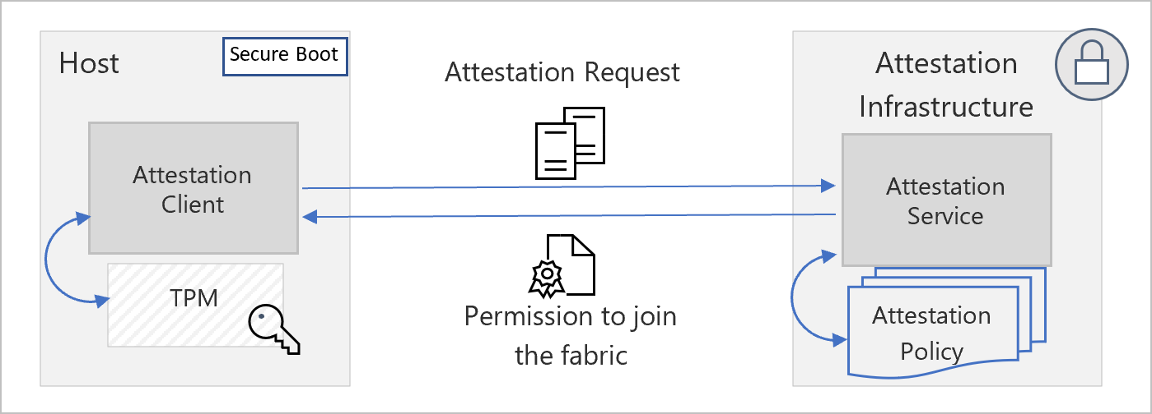
Built on a secure foundation Principle: Build a comprehensive strategy
Protect customer data
Secure hardware
Test and monitor
Azure Active Directory manages access to Azure resources.
Azure Key Vault stores sensitive data such as certificates, connection strings, and tokens.
Azure Security Benchmark provides recommendations to improve the security of your workloads, data, and services.
Azure is hosted on custom-built hardware with integrated security.
Host Attestation Service ensures host machines are trust-worthy before allowed to interact with customer data.
Run simulated penetration attacks to detect system vulnerabilities and validate defenses.
Classify, protect, and monitor sensitive data assets using access control, encryption, and logging.
Host attestation service high-level architecture
Notes:
Invest in culture, processes, and security controls across system components. Consider security for the full lifecycle—software, hardware, and services supply chain
Azure is architected for secure multi-tenancy. It’s designed to abstract much of the infrastructure that typically underlies applications (servers, operating systems, Web and database software, and so on) so that developers can focus on building applications—and not on managing resources. The goal is to provide a secure, consistent, scalable set of resources for each customer that they can manage through a subscription, created through www.windowsazure.com and associated with a Microsoft account or organizational account. A set of Azure technologies isolate each customer’s environment from others:
How we secure the Azure platform
talk about our SDL process here https://www.microsoft.com/en-us/securityengineering/sdl/threatmodeling
The Fabric Controller is the central brain that secures and isolates customer environments by sending commands to the Host OS and the Hypervisor.
The Host OS is a configuration-hardened version of Windows Server.
The Hypervisor is Hyper-V from Windows Server 2012, which has been battle-tested and proven in enterprise environments worldwide
The Guest VM OS can be either Windows Server or chosen and supplied by the customer. (Customer-controlled VMs are called guest VMs, and the guests that run on them are the guest OS.)
Graphic location: https://docs.microsoft.com/en-us/azure/security/fundamentals/measured-boot-host-attestation

Slide 40


Built on a secure foundation Principle: Assume Zero Trust
DDoS protection
Web Application Firewall
Azure Firewall
Network Security Groups
VNET Integration
DDOS protection tuned to your application traffic patterns
Centralized inbound web application protection from common exploits and vulnerabilities
Data exfiltration protection with centralized outbound & inbound (non-HTTP/S) network & application (L3-L7) filtering
Distributed inbound & outbound network (L3-L4) traffic filtering on VM, Container or subnet
Virtual network-restricted access to Azure service resources (PaaS)
Application protection
Segmentation
Notes:
Protection to your Azure service resources from the internet by allowing access only to your Virtual Network.
Review the main points under each section.
Let’s talk about the next Security principle: Leverage native controls.

Slide 41
Proactively stay secure with native controls (1 of 2) Principle: Leverage native controls
Built-in Azure controls
Identity & access | Apps & data security | Network security | Threat protection | Security management
In-depth defense
Eliminate and reduce effort required to integrate external security tooling, and update integrations with service provider-supported native controls
Notes:
Microsoft has invested, across: identity and access management, apps and data security, network security, threat protection, and security management. ​
​
We’ve put a tremendous amount of investment into these areas and the way it shows up is across a pretty broad array of product areas and features. ​
​
Identity and Access Management tools enable you to take an identity-based approach to security, and establish truly conditional access policies​
App and Data Security help you protect your apps and your data as it moves around—both inside and outside your organization​
Azure includes a robust networking infrastructure with built-in security controls for your application and service connectivity. ​
Built-in and fully integrated threat protection capabilities , so you can strengthen both pre-breach protection with deep capabilities across e-mail, collaboration services, and end points including hardware-based protection; and post-breach detection that includes memory and kernel-based protection and response with automation.​
Security Management tools give you the visibility and more importantly the guidance to manage policy centrally​
Customers ask what do I control? How do I manage my data, and secure access to it?
These defense in depth strategies, from Identity, the new perimeter of a cloud native, mobile first world, to Security Management where I want a unified view of my hybrid environment.
These tools come from Microsoft and partners in our eco-system, expanding the choices for our defense in depth strategies.

Slide 42
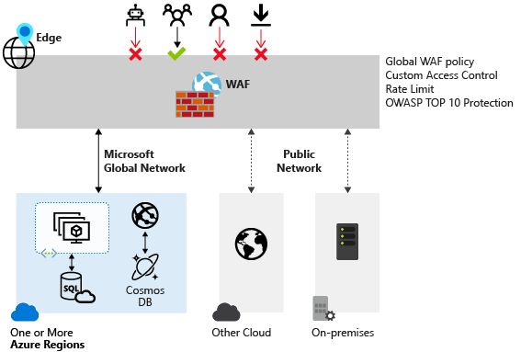
Proactively stay secure with native controls (2 of 2) Principle: Leverage native controls
Azure Security Center
Web Application Firewall
Azure Active Directory
Unified infrastructure security management system:
Strengthens the security posture of your data centers.
Provides advanced threat protection across hybrid workloads in the cloud—on Azure, or on-premises.
Centralized protection and inspection of HTTP requests to prevent attacks such as SQL Injection or Cross-Site Scripting.
AAD's cloud-based identity and access management service helps organizations to securely access resources across environments.
Managed Identities eliminates the need to store credentials that could be leaked.
Azure AD Connect synchronizes Azure AD with an existing on-premises directory.
Notes:
What are the tools for identity and access management, apps and data security, network security, threat protection, and security management?​
Security Center addresses the three most urgent security challenges:
Rapidly changing workloads
Increasingly sophisticated attacks
Security skills are in short supply
ASC benefits:
Strengthen security posture
Protect against threats
Get secure faster
WAF provides:
Protection, monitoring, and several customization options.
Azure AD
Provides cross-environment identity and access management for your organization:
External resources (Microsoft 365, Azure portal, and thousands of other SaaS applications)
Internal resources (corporate network & intranet apps, proprietary cloud apps

Slide 43


Detect and respond to threats Principle: Design for Resilience
Native security & governance
Native threat detection
ASC/Secure Score
SIEM
Azure Sentinel
Firewall
Multi-cloud
3rd-party and partners
Web App Firewall
Microsoft 365 Defender
Azure Defender
Email/docs
Endpoints
SQL
Server VMs
Containers
SQL Protection
Identities
Apps
Network traffic
IoT
Apps
API Protection
XDR
Microsoft Defender
Notes:
Design for resilience with cloud-native security & governance, as well as threat detection.
Threat landscape is becoming more complex with increasing sophistication of attacks and wider attack surfaces.
Security teams struggle to manage this environment with multiple solutions that are often not integrated.
Results in serious threats avoiding detection due to data being collected & analyzed in silos, as well as security teams suffering from alert fatigue.
Further pressure on resources is felt from a worldwide shortage of skilled security practitioners.
We need intelligent, automated, integrated security to close the gaps, providing visibility and proactive response across the organization.
unique approach that empowers security professionals with both SIEM and extended detection and response (XDR) tools from a single vendor with an emphasis on integration so that defenders get the best of both worlds – end to end visibility across all of your resources, and intelligent alerts built with a deep understanding of individual resources and filtered with AI. With the combination of SIEM and XDR, defenders can now focus on what’s important, namely mitigating threats, armed with more context than ever, and spend less time on infrastructure, or the large volume of low fidelity signals.
Azure Sentinel (cloud-native SIEM)
Delivers intelligent security analytics for your entire enterprise.
Connect to any of your security sources using built-in connectors and industry standards and then take advantage of artificial intelligence to correlate multiple low fidelity signals spanning multiple sources to create a complete view of a kill chain and prioritized alerts so that defenders can accelerate their time to evict adversaries.
Free yourself from managing infrastructure and always have the capacity you need to mitigate active threats.
Two of the key inputs to any SIEM for many customers are Microsoft 365 security data spanning users, devices, applications and infrastructure data from Microsoft Azure and hybrid environments including virtual machines or storage or SQL databases.
Microsoft Defender:
Leverages XDR capabilities with detailed understanding of Microsoft 365 and Microsoft Azure,
Applies artificial intelligence and automation at a resource level and filter out the most important alerts to surface in the SIEM.
Delivers broadest resource coverage of any XDR on the market—spanning users, device, application, virtual machines, SQL databases, IoT, etc.
Includes Azure Defender and Microsoft 365 Defender, enabling security professionals to immediately identify and remediate issues.
Azure Defender
Protects Azure and hybrid environments and ensures your cloud infrastructure resources are protected from common threats such as brute-forcing virtual machines, or attacking storage or SQL injection, or even mitigating threats against containers, the key management service or IoT devices.
Delivers protection for resources from within the Azure experience and extends protection to on-premises and multi-cloud virtual machines and SQL databases using Azure Arc.
Customers already using Azure Security are already using Azure Defender capabilities and with the Azure Defender announce we are not just rebranding these capabilities but also simplifying the experience for defenders with a central operational dashboard where you can easily tell at a glance which resources are protected and your alert status across all resources. In addition, we have continued to enhance the threat protection capabilities with extended detection and response now available for SQL on-premises and enhancements to container threat protection.
Microsoft Defender high-level details:
Combination of SIEM and XDR delivers breadth of resource coverage of a SIEM with XDR in integrated/open package.
Empower SecOps teams to spend less on security system set up and maintenance, less time on false alarms.
Focus on quickly identifying threats, even never-before-seen attacks, streamline threat investigation and automate remediation, as threat landscape evolves.
When configuring and optimizing workloads, focus on finding and remediating security threats.

Slide 44

How can you get started?
Optimize existing workloads
Design & deploy new workloads
Leverage Azure Advisor Score to identify optimization opportunities
Understand changes needed or incidents occurred
Review Well-Architecture Framework
Consider architecture design trade offs to achieve business goals
Define and implement recommendations
Establish a regular cadence for workload optimization
Align workload architecture to business priorities
Review Well-Architecture Framework
Leverage the Azure Well-Architected Review to assess workload architecture design
Consider architecture design trade offs to achieve business goals
Build, deploy and manage workloads on Azure

Slide 45

Sample Engagement Agenda
We are here
Day 1
Day 2
Day 3
Introduction
Review tooling and results, educate on recommended tools
Present final report
Morning Session
Workload overview Whiteboarding session
Well-Architected Review & Advisor
Draft reporting deliverables
Plan next phases Program builder
Afternoon Session
Customer participation required

Slide 46
Optimize existing workloads – Engagement Overview Process
Collect data to identify optimization opportunities
Gather
Analyze
Advise
Implement
Next Step
Implement recommendations and continuous process
Confirm optimization opportunities
Actionable plan and recommendations to optimize
Notes:
This slide describes the workload optimization process.
First, work with your teams to gather and analyze data to identify and confirm optimization opportunities. Then review recommendations on which opportunities to pursue. Then implement recommended optimizations and set up reviews going forward.

Slide 47
Technical Areas of Expertise Needed for Operational Excellence Workshop
Architecture
Operational Procedures
Design
Targets & Non-Functional Requirements
Key Scenarios
Dependencies
Application Composition
Recovery & Failover
Scalability & Capacity Model
Configuration & Secrets Management
Operational Lifecycles
Patch & Update Process (PNU)
Health Modelling
Deployment & Testing
Application-Level Monitoring
Resource/Infrastructure Level Monitoring
Data Interpretation & Health Modelling
Dashboarding
Alerting
Application Deployments
Application Infrastructure Deployments & Infrastructure as Code (IaC)
Build Environments
Testing & Validation
Security & Compliance
Operational Model & DevOps
Identity and Access
Security Center
General
Roles & Responsibilities
Common Engineering Criteria
Notes:
It’s important to identify and include stakeholders with expertise in these specific areas.

Slide 48
Technical Areas of Expertise Needed in Performance Efficiency Workshop
Application Design
Monitoring
Design Patterns
Transactional
Disaster Planning
Logging
Performance Targets
Capacity Planning
Performance Testing
Usage Prediction
Service SKU
Disaster Recovery
Resource & Performance Planning
Load Capacity
Test Coverage
Benchmarking
Tooling
Troubleshooting
Operational Model
DevOps
Notes:
It’s important to identify and include stakeholders with expertise in these specific areas.

Slide 49
Technical Areas of Expertise Needed for Reliability Workshop
Architecture
Operational Procedures
Design
Targets & Non-Functional Requirements
Key Scenarios
Dependencies
Application Composition
Recovery & Failover
Scalability & Capacity Model
Configuration & Secrets Management
Operational Lifecycles
Patch & Update Process (PNU)
Health Modelling
Deployment & Testing
Application-Level Monitoring
Resource/Infrastructure Level Monitoring
Data Interpretation & Health Modelling
Dashboarding
Alerting
Application Deployments
Application Infrastructure Deployments & Infrastructure as Code (IaC)
Build Environments
Testing & Validation
Security & Compliance
Operational Model & DevOps
Identity and Access
Security Center
General
Roles & Responsibilities
Common Engineering Criteria
Notes:
It’s important to identify and include stakeholders with specific expertise in the workshop.

Slide 50
Technical Areas of Expertise Needed for Security Workshop
Architecture
Security Operations
Plan & Design
Business Outcomes
Core, Workload, & Hybrid Dependencies
Cloud Adoption Framework & Security Benchmarks
Shared Responsibility
Detect & Respond, Alert & Monitor (Sentinel)
Threat Intelligence
Proactive Threat Hunting
Incident Management & Recovery
Red Team / Blue Team Exercises
Security Governance
Asset Protection
Posture Management (Security Center)
Policy, Standards, & Compliance (NIST, CIS, Industry)
Data & Information Management
Metrics, KPI, & Dashboarding
Asset Inventory, Patch & Update
Network Isolation
Firewall & Web Application Firewall, DDoS
Encryption, Certificates, Keys, & Secrets
Discovery & Classification
Innovation Security
Access Control
Application/Infrastructure Deployments
DevOps, Infrastructure as Code (IaC), CI/CD
Minimum Viable Security Product (ESLZ, WAF)
Access, Roles, & Permissions (RBAC, ABAC, Entitlements)
Zero Trust Access Control (Conditional Access & MFA)
Privileged Access
Notes:
It’s important to identify and include stakeholders with specific expertise in the workshop.

Slide 51

Customer Stakeholders (Example)
Solution Architect
Cloud Architect
Operations Architect
DevOps / SRE Lead
SecOps Lead
Solution Owner
Solution Architect
Cloud Architect
Network Architect
Data Architect
Security Architect
DevOps / SRE Lead
Project Manager
Notes:
Each role brings a unique point of view to the conversation.

Slide 52



Technical Workshop Approach
Microsoft-led review workshop lasting 1-to-2 days
Can be delivered as compressed virtual workshops spanning 2-to-4 hours
‘Top-down’ end-to-end assessment of the entire application and its design path
Covering all significant technical domains
‘Question & Answer’ format applied to solicit key data points
Relevant application context is required to identify risks and align associated recommendations
Notes:
Here are some specifics about how the workshop is conducted
During this workshop, we will:
Assess the end-to-end operations of the workload’s current state
Design trajectory to identify critical risks
Gain insights into the workload as well as the broader organization and cloud environment

Slide 53



Key Outcomes
Identify key risks of the application, across prioritized well-architected pillars
Propose actionable and prioritized recommendations to address identified risks
P0 – Critical short-term remediation
P1 – Strongly recommended mid-term improvements
P2 – Long-term sustainability recommendations
Capture key findings and associated recommendations in a Well-Architected report focused on the reviewed workload
Provide guidance for implementing critical short-term recommendations
Notes:
This is what you can expect at the end of the workshop.

Slide 54

Architect & optimize workloads for success
Leverage assessment
Azure Well-Architected Review
(aka.ms/wellarchitected/review)
Get trained
Well-Architected Learning Path
(aka.ms/wellarchitected/ learn)
Browse Reference Architectures
Azure Architectures
(aka.ms/wellarchitected/ referencearch)
Azure Enablement Show
Channel 9 Show
(aka.ms/azenable)
Review Design Principles
Well-Architected Design Principles
(aka.ms/wellarchitected/ designprinciples)
Review the Documentation
Azure Well-Architected Framework
(aka.ms/wellarchitected/framework)
Engage a partner
Azure Partners
Find Service Offers
MS Consulting Services
(aka.ms/WAFServices)
Notes:
Technical documentation, assessments
Well-Architected Learn Path
Cloud agnostic design patterns for building reliable, scalable, secure applications
Guidance for architecting solutions on Azure with established patterns and practices
NEW – Azure Enablement Show

Slide 55
Thank you!

Slide 56
Additional Supporting slides

Slide 57
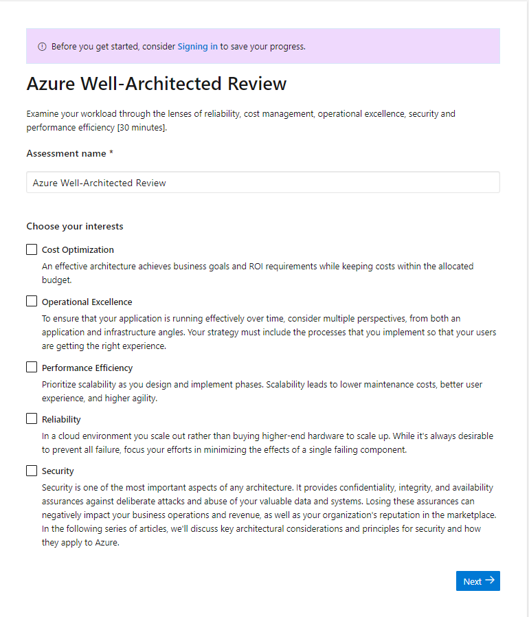
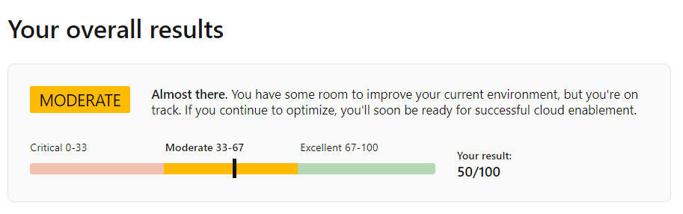
Well-Architected Review Online Tool
Assess your workloads using the tenets found in the Microsoft Azure Well-Architected Framework:
Understand the Well-Architected level of your workload environment.
Access guidance for next steps of your workload improvement process.
aka.ms/wellarchitected/review
Notes:
Then, the Well-Architected Review will help you, with a set of simple guided questions, to assess your workloads operational capabilities and give you guidance for the next steps of your workload improvement process.

Slide 58
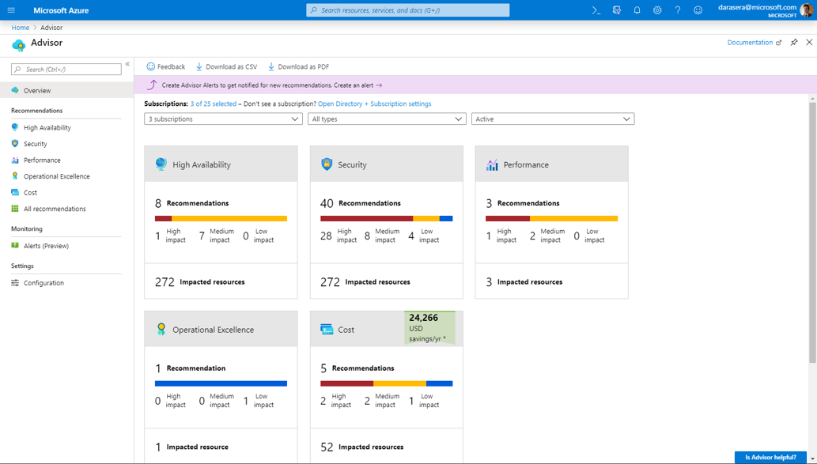
Azure Advisor
Practical recommendations based on your usage and configurations, such as:
Create Azure Service Health alerts.
Delete and re-create your pool to remove a deprecated internal component.
Repair invalid log alert rules.
Design your storage accounts to prevent reaching the maximum subscription limit.
Azure.com: aka.ms/advisor Tool: aka.ms/azureadvisor Documentation: aka.ms/docs/advisor
Notes:
Let’s start with Azure Advisor. This tool analyzes your configurations and usage telemetry and offers personalized, actionable recommendations to help you optimize your Azure resources.

Slide 59
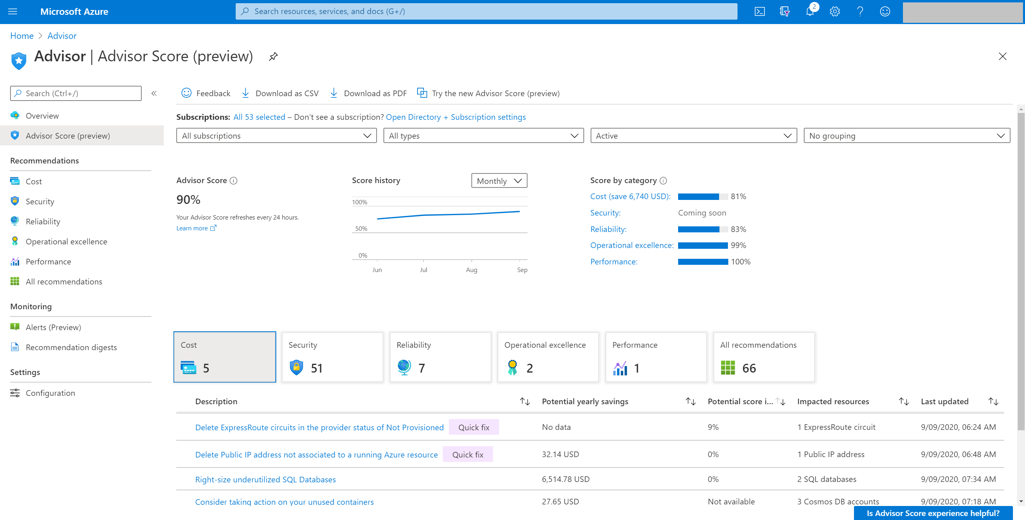
Advisor Score A core feature of Azure Advisor that aggregates recommendations into a simple, actionable score.
Personalized and actionable best practice recommendations, including how to:
Improve the posture of your workloads and optimize your Azure deployments.
Proactively prevent top issues by following best practices.
Assess your Azure workloads against the five pillars of the Microsoft Azure Well-Architected Framework.
Azure.com: aka.ms/advisor
Tool: aka.ms/azureadvisor
Documentation: aka.ms/docs/advisor
Notes:
Advisor displays your overall Advisor score and a breakdown for Advisor categories, in percentages. A score of 100% in any category means all your resources assessed by Advisor follow the best practices that Advisor recommends. On the other end of the spectrum, a score of 0% means that none of your resources assessed by Advisor follow Advisor's recommendations
Using these score grains, you can easily achieve the following flow:
Advisor Score helps you baseline how your workload or subscriptions are doing based on an Advisor score. You can also see the historical trends to understand what your trend is.
Score by category for each recommendation tells you which outstanding recommendations will improve your score the most. These values reflect both the weight of the recommendation and the predicted ease of implementation. These factors help to make sure you can get the most value with your time. They also help you with prioritization.
Category score impact for each recommendation helps you prioritize your remediation actions for each category.

Slide 60
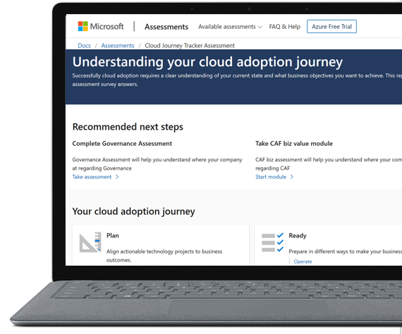
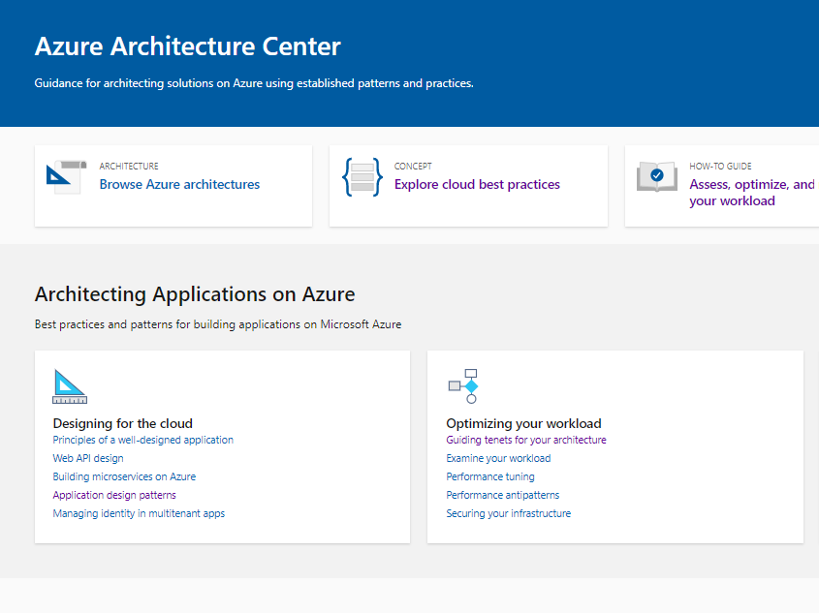
Microsoft Azure Architecture Center
Documentation
https://aka.ms/architecture
Notes:
Azure Architecture Center
Guidance for architecting solutions on Azure using established patterns and best practices to design and build more scalable, resilient, and manageable applications on Azure.

Slide 61
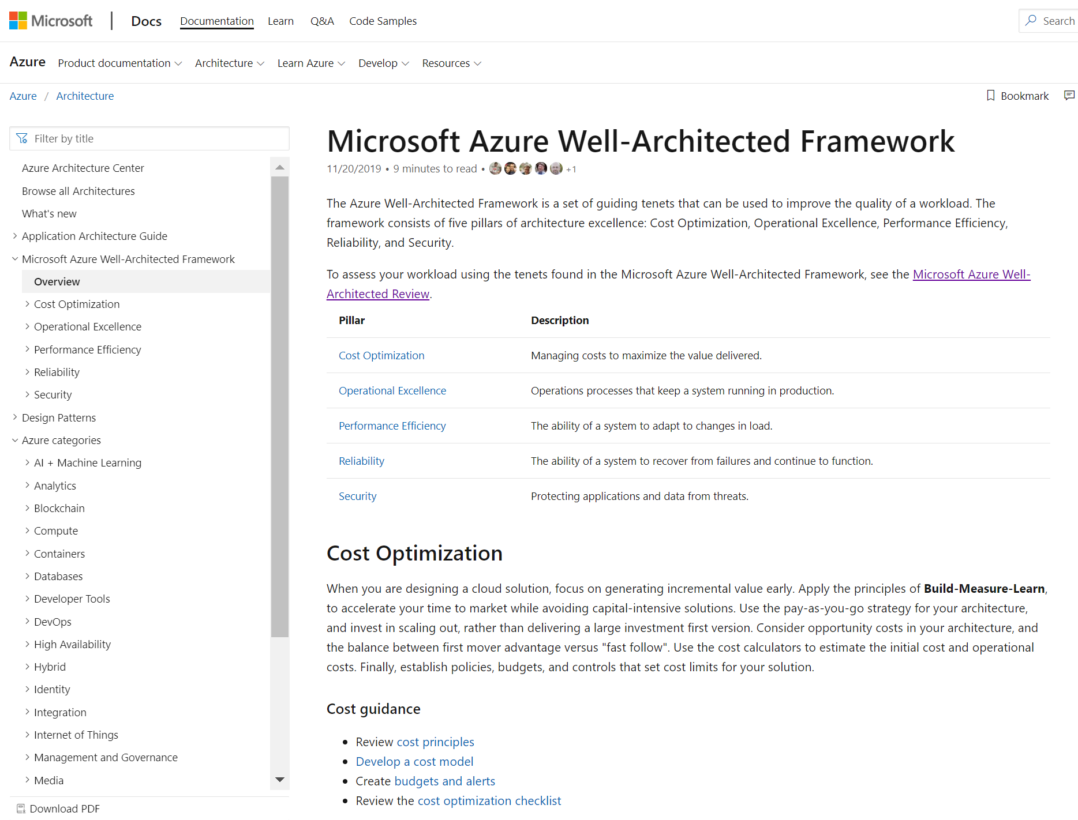
Microsoft Azure Well-Architected Framework
Documentation
https://aka.ms/wellarchitected/framework
Notes:
Microsoft Azure Well-Architected Framework
The Microsoft Azure Well-Architected Framework is a set of guiding tenets that can be used to improve the quality of a workload.
The framework consists of five pillars of architecture excellence: Cost Optimization, Operational Excellence, Performance Efficiency, Reliability, and Security

Slide 62
Well-architected solutions enable—
cost optimization
It’s more critical than ever for customers to get a handle on forecasting and cost optimization¹
Customers reported their public cloud spend was over budget by an average of 23 percent¹
Respondents expect their cloud spend to further increase by 47 percent in the next 12 months.
Organizational spend on public cloud
Average % across all respondents
Current Spend
Growth in next 12 months
Next 12 months
47%
Original Budget
Amount over budget
Current cloud spend
23%
N=750
¹ Flexera 2020 State of the Cloud Report
Notes:
Well-architected solutions enable customer success. Let’s look at what cost-optimization can do for you.
You’re building a cost-conscious organization—that’s visible, accountable, and optimized. Where do you begin?
Start to forecast—and optimize cost across your organization.

Slide 63

Well-architected solutions enable— cost savings in security spend
In 2019, encryption, business continuity management, DevSecOps, and threat intelligence sharing mitigated cost¹
Encryption reduced breach costs by an average of $360,000.
Business continuity management reduced the total cost of a data breach by an average of $280,000.
¹ The Cost of a Data Breach Report, IBM Security, 2019. Conducted by Ponemon Institute LLC
Notes:
Well-architected solutions enable customer success. Let’s look at lowering security cost.
You’re still building a cost-conscious organization—visible, accountable, and optimized.
Continue to optimize security spend across your org—which means mitigating cost.

Slide 64
Well-architected solutions enable— cost savings with resiliency, high-availability, and security automation strategies
Companies with incident response teams with testing of IR plans —saved over $1.2 million¹.
Organizations without security automation experienced breach costs 95 percent higher
Breach costs rose above 16 percent at organizations without automation deployed, going up from an average of $4.43 million in 2018 to $5.16 million in 2019.
Breach costs decreased by 8 percent at organizations with fully deployed automation, from 2018 to 2019, from an average of $2.88 million in 2018 to $2.65 million in 2019.
¹ The Cost of a Data Breach Report, IBM Security, 2019. Conducted by Ponemon Institute LLC
Notes:
Well-architected solutions enable customer success. Let’s look at what cost-optimization can do for you.
Keep your cost-conscious organization in mind—visible, accountable, and optimized.
Continue to optimize—and focus on cost savings—building resiliency and HA (Highly-Available)
Bake in security automation into your secure architecture design
Companies with IR teams + testing saves IT budget dollars!
Orgs without security automation have highest $$ risk.

